Slide 1
TEAM : CSE - 004
AMAZING AI

Slide 2
NATURAL GAS PRICE PREDICTION
DEVELOPED BY:
Venu Chennapai
Saipriya Aitha
Keerthana Muppala
Sumanth Chikka

Slide 3


NATURAL GAS PRICE PREDICTION
Main
our moto is to discuss overview of Natural Gas price prediction using the machine learning models to find the predict values of the specific scope , accuracy and also deal the future scope of advantages and disadvantages those applications

Slide 4
CONTENTS
Introduction
1
Overview
2
Advantages and Disadvantages
3
Applications and Future scope
4

Slide 5
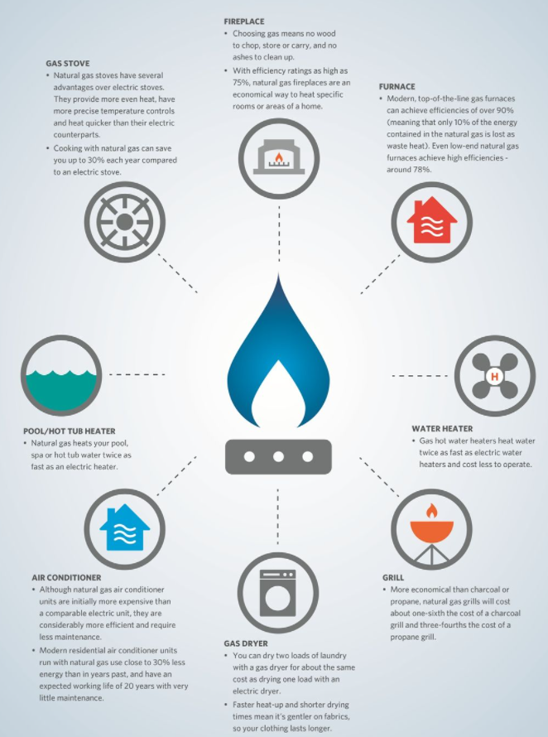
Introduction:
Natural gas has been proposed as a solution
to increase the security of energy supply
and reduce environmental pollution around
the world.
Being able to forecast natural gas price
benefits various stakeholders and has
become a very valuable tool for all market
participants in competitive natural gas
markets.
Machine learning algorithms have
gradually become popular tools for natural
gas price forecasting.

Slide 6
Overview:
To predict the price of natural gas through machine learning we are using algorithms like Svm and Decision Tree Regression.
By applying Svm algorithm we are splitting the dataset.With the help of Decision Tree Regression we are finding the accuracy.
For creating an user interface for prediction we used flask and scripting language Html to create a web page.
This is mainly helpful for stakeholders to predict the prices.

Slide 7
TOOLS
1. Jupyter Notebook Environment and Google Colab
2. Anakonda Spyder Ide
3. Machine Learning Algorithms (Regression / Classification)
4. Python (pandas, numpy, matplotlib, seaborn, sklearn)
5. HTML Code
6. Flask

Slide 8
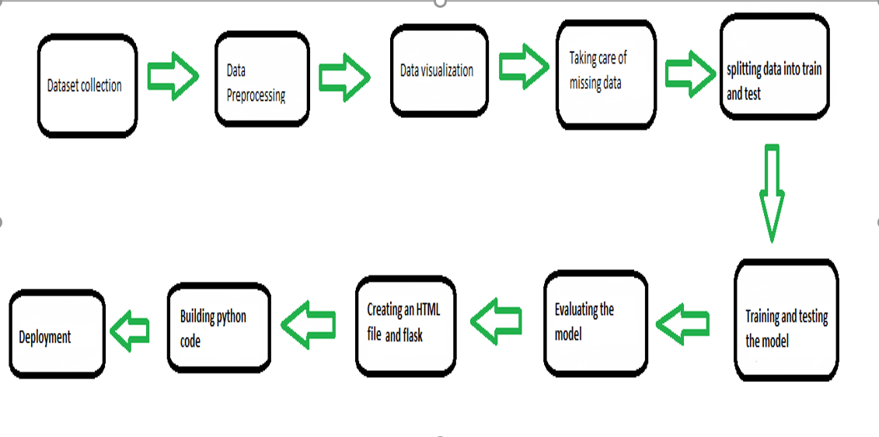
BLOCK DIAGRAM

Slide 9
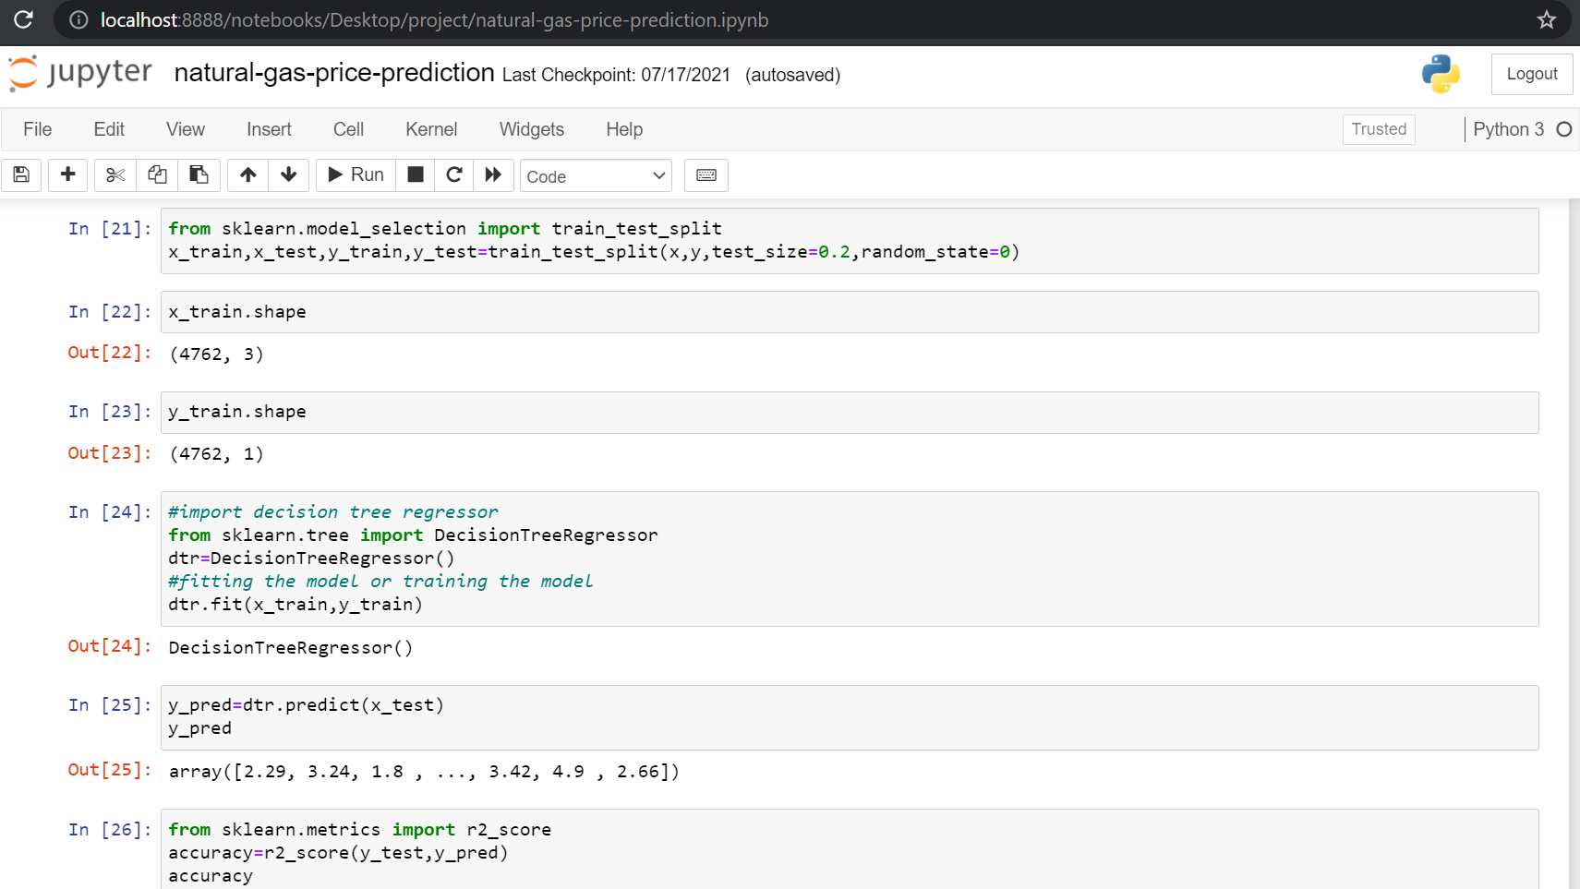

Slide 10
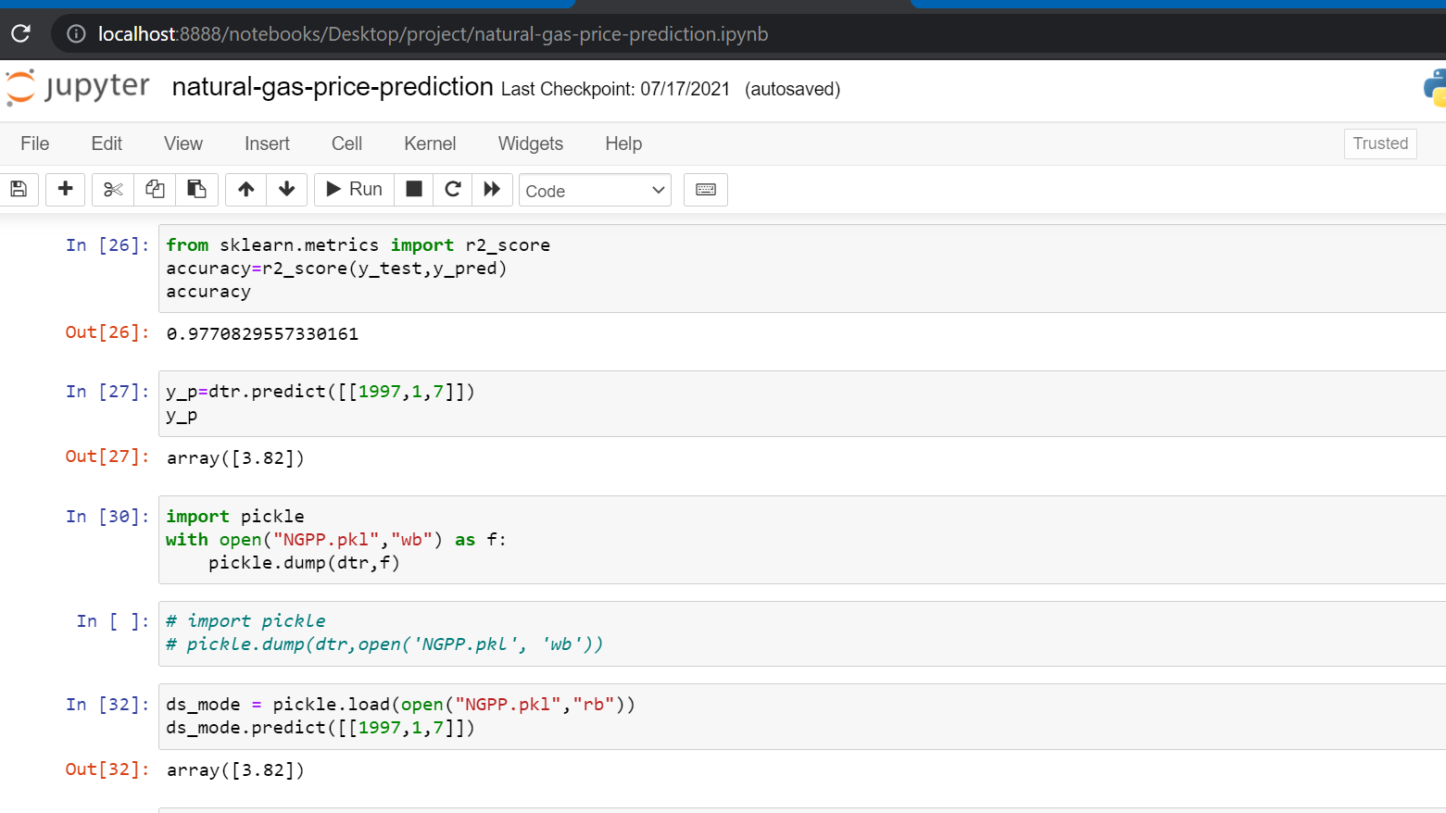

Slide 11


Slide 12
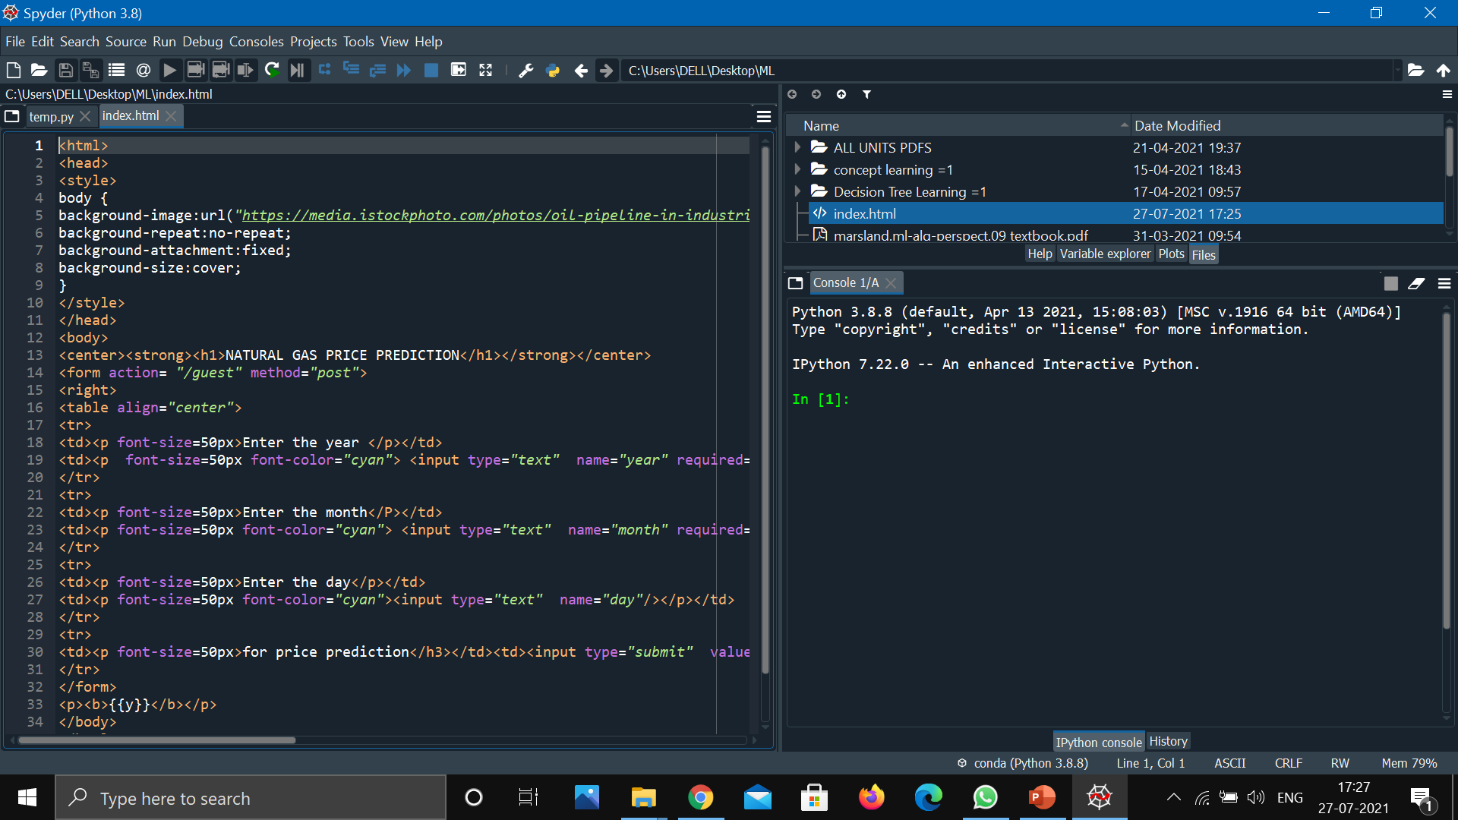

Slide 13
Advantages and Disadvantages
Advantages :-
a)Natural Gas is Environmentally Clean: Among many burning fossil fuels available on planet earth, natural gas is the most cleanest. It is considered clean because unlike other gases, natural gas emits very less byproducts into the atmosphere as pollutants. This keeps the air we breathe cleaner.
b)It is Economical: Natural gas is not as expensive as other burning fuels.
c)It is Convenient: If people use natural gas for cooking or electric purposes, it can be directed connected to the consumer’s house with the help of pipelines. This eliminates the long process of collecting, processing, packing, and delivering the end product to the customers.
d)Natural Gas is Safe to Use: One of the biggest fear we have when using LPG cylinders or any other type of fuel is the possibility of leakage. Gases have the power to burn things and people around and can be very dangerous. However, natural gas is lighter than air. In case of a leakage, it dissipates quickly into the air avoiding fire. Isn’t that super safe?
e)It is Available Abundantly: Currently, experts state that amount of natural gas available is more than crude oil or other such products.
f)It is More Efficient: When compared to things like propane gas, natural gas provides more energy when it burns, which makes it much more efficient.

Slide 14
Advantages and Disadvantages
Disadvantages :-
a)Limited Quantities: The problem in India is that we don’t have vast reserves of natural gas which means that most of the natural gas that is consumed by us has to be bought from other countries. Such constant purchases can turn into a rather expensive proposition over time.
b)Natural Gas is Highly Combustible: Though natural gas is lighter than air, one cannot deny the fact that is it highly combustible. As natural gas is odourless, it is difficult to detect a leakage as well.
c)Natural Gas is a Non-Renewable Source of Energy: Keeping aside the positives of using natural gas, one should not forget that it is a non-renewable source of energy. Experts state that natural gas will be depleted in the future and we will have to import it from other nations.
d)Natural Gas Emits Carbon Dioxide: One of the biggest disadvantage of natural gas is that it emits carbon dioxide which is bad for our atmosphere. Constant introduction of carbon dioxide into our atmosphere will lead to climate change and also global warming.
e)Long Processing Process: As natural gas has other components that has to be removed before using it for residential or commercial purposes, it takes a lot of time and manpower to process it.
f)Leakage: Even though it is lighter than air and can disperse easily, a big danger with natural gas is that since it is colorless, odorless and tasteless, should it start leaking, detection of the leak is very hard. Advantages of Natural Gas.

Slide 15
Applications:
we can also use this model to predict , different sectors like business, bank, salaries etc...
So we use Machine Learning Algorithms to analyze the data and propose what stakeholders and business companies need to achieve their needs.
Forecast the natural gas price ,benefits various stakeholders and business persons ,whether to buy or invest in natural gas industry with our model

Slide 16
Future Scope:
This Decision Tree Regression model can also be used in the future predictions like weather forecast, job prediction, salary prediction etc.
In future we can create a web application on this type of problems, so that it can be accessed from everywhere with more users.

Slide 17
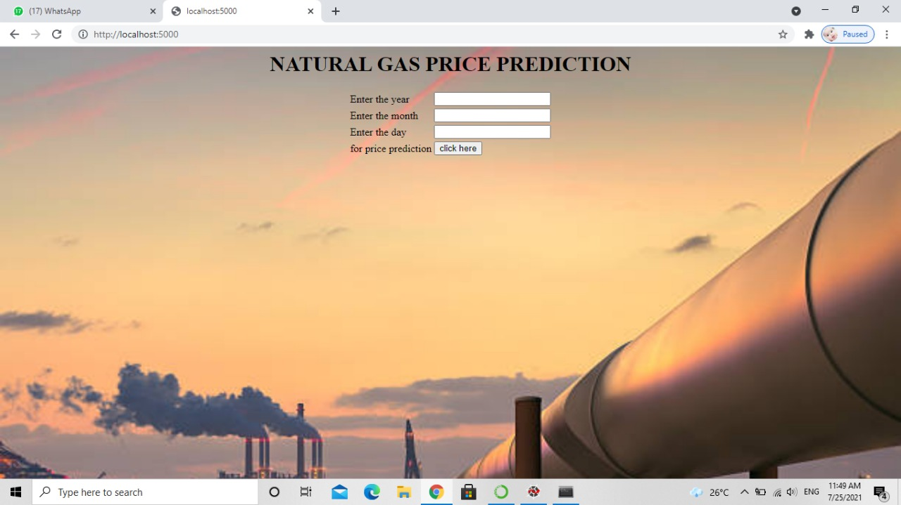

Slide 18
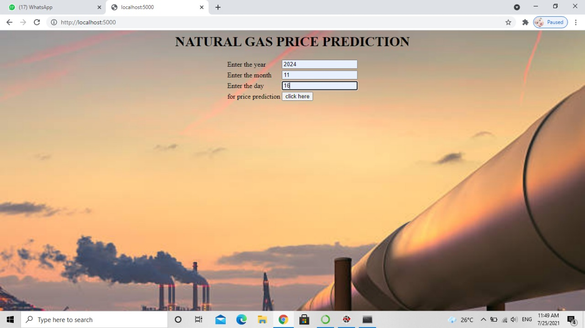

Slide 19
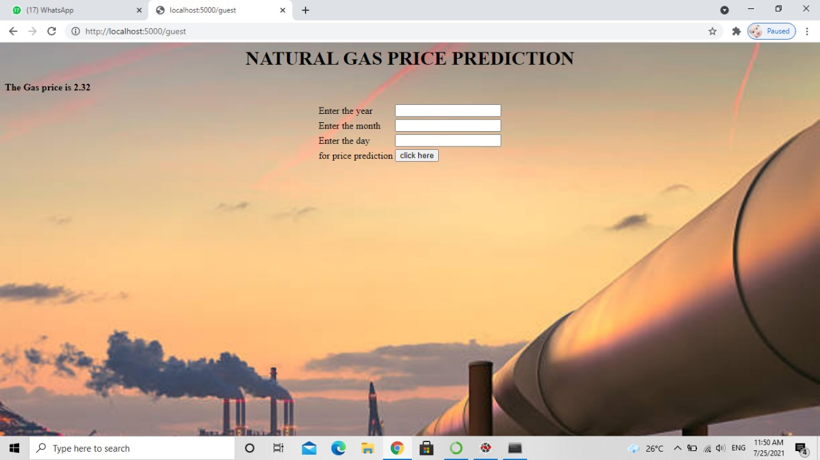

Slide 20
THANK YOU !

